Slide 1





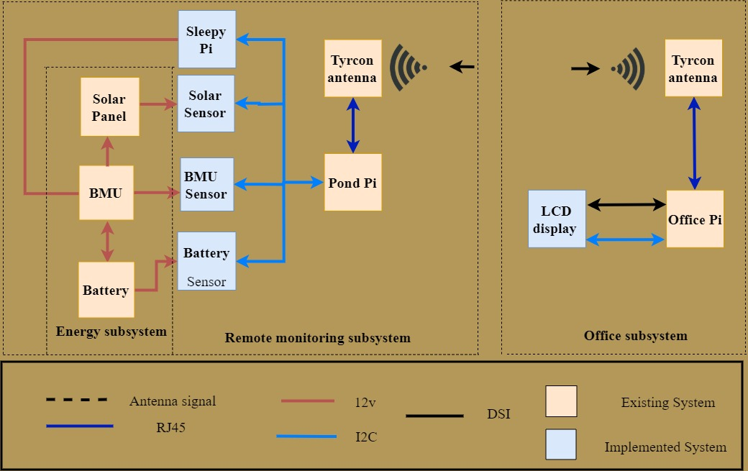
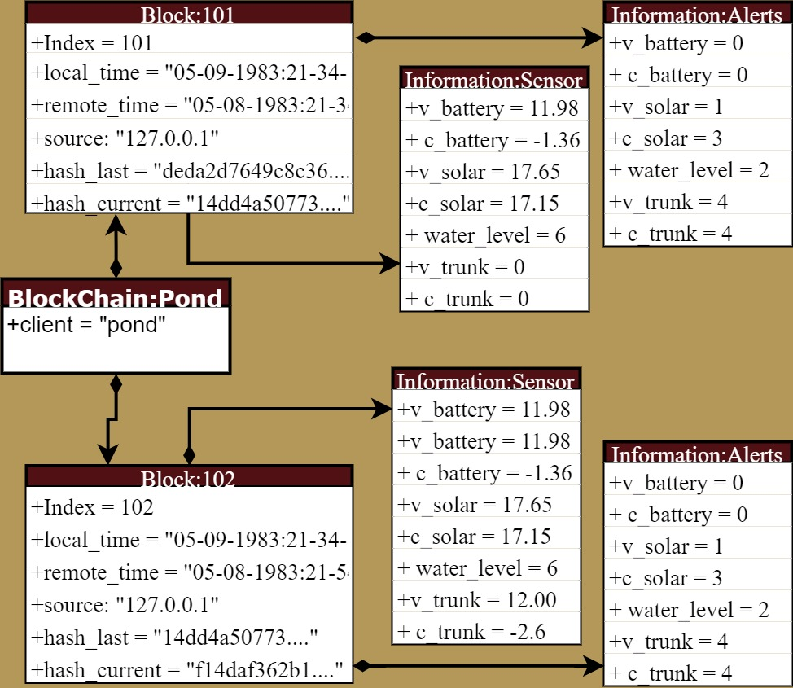
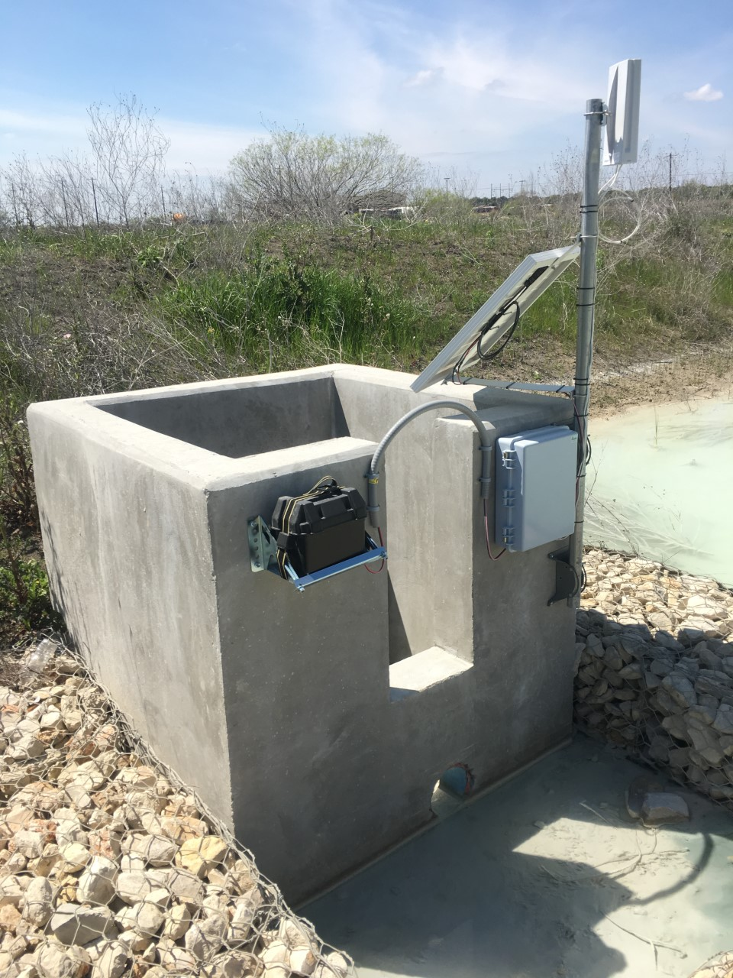



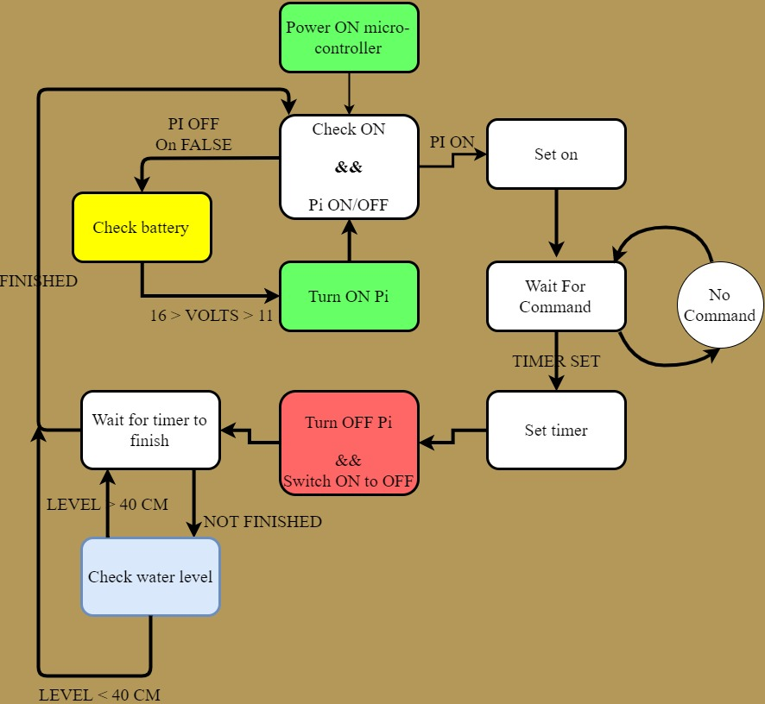
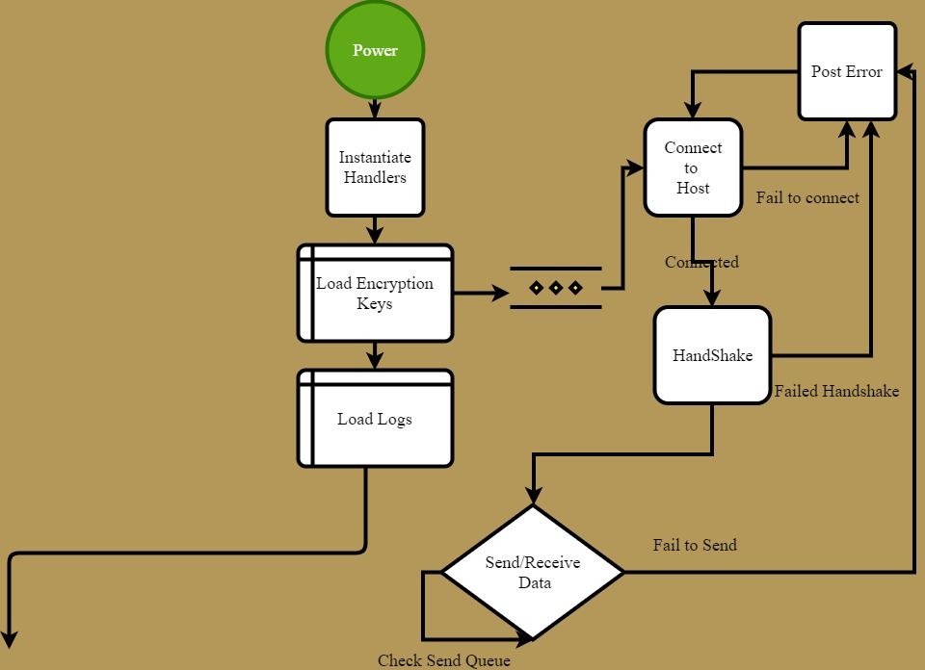


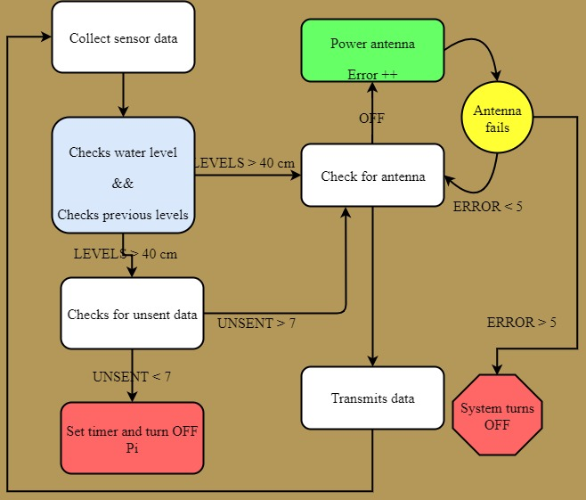
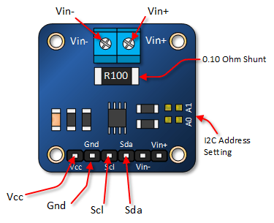
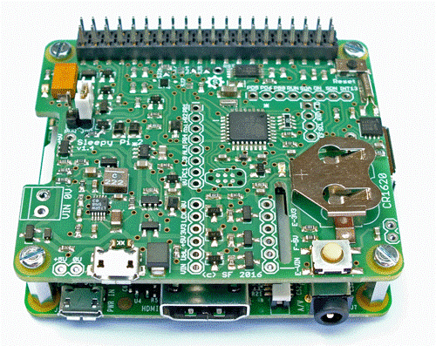
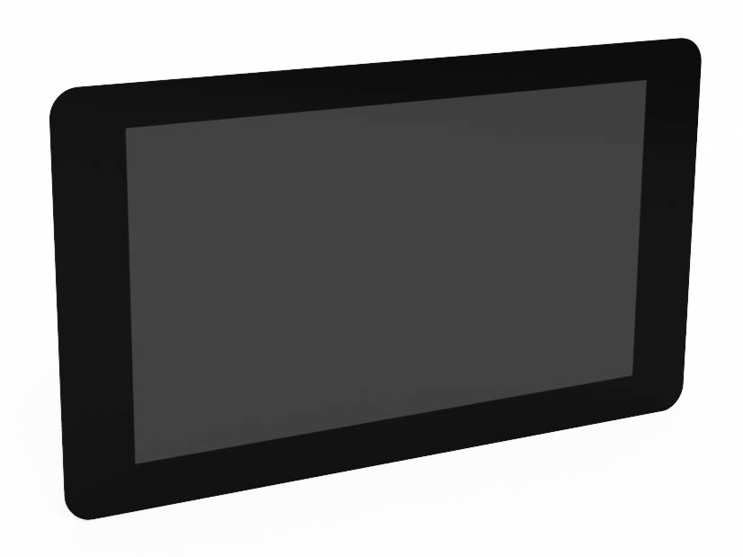
E2.01- Ingram Readymix Secured Network
Ahmed Al Qaysi, Nicholas Holleman, Andres Oliva
Sponsor: Mr. Charlie Tuttle
The Project
Hardware Design
Requirements & Results
Our project upgrades a remote retention pond with new hardware and software. This includes:
Power management
Blockchain ledger
Graphical user interface
Encryption (Security)
Hardware Implemented:
Microcontroller
RTC
Sleep Mode
LCD
Replace LED strip
Pass-Present data
Sensors
Battery life
Voltage
Current
Features | Requirements | Data
Data Ledger | Verifiable data record. Store 3 years of records | Storage size: 1.85 Gbytes
Power Management | 3-day minimum battery life
Remote Retention Pond Flow Chart
Microcontroller
Both Devices are located in a IP65 rated box at the Pond.
Microprocessor
Communication | Neglects unauthorized transmissions. | Retransmitted Blocks: 1.2% Time to Transmit: 1.02 seconds
Overall System | Samples sensor every 30 seconds.
Motivation
The Ingram Readymix facility is under a TCEQ permit that requires the plant to report a water sample within 30 minutes when water leaves through a storm drain.
Network Communication
TCP
Encryption : RSA
I2C
Microcontroller management
Data Ledger
Block Chain
Error Handling
Sensors
Network
Power Subsystem
Hardware
Communication
I2C
UART
Power Management
Relay control
Graphical User Interface | Display past and current water level, Battery life, 3 Clicks maximum to any location within GUI
Acknowledgements
Protection
Over-voltage shutdown
Under-voltage lockout
Dr. Stan McClellan
Mr. Mark Walker
Mr. Charlie Tuttle

